Slide 1

Chapter 4.1
Loss System M/M/n
Performance Evaluation of the Internet of Things (IoT)
Module Course: Performance Evaluation of Distributed Systems
Prof. Tobias Hoßfeld, Summer Semester 2022

Slide 2

Disclaimer and Copyright Notice
Lecture slides, figures, and scripts are based on the open access text book “Performance Modeling and Analysis of Communication Networks”. The book and scripts are licensed under the Creative Commons License Attribution-ShareAlike 4.0 International (CC BY-SA 4.0). If you remix, transform, or build upon the material, you must distribute your contributions under the same license as the original.
The book must be cited and the disclaimer attached when using lectures slides or scripts.
Tran-Gia, P. & Hossfeld, T. (2021). Performance Modeling and Analysis of Communication Networks - A Lecture Note. Würzburg University Press. https://doi.org/10.25972/WUP-978-3-95826-153-2
Website to download book, exercises, slides and scripts: https://modeling.systems/

Slide 3
Chapter 4
4 Analysis of Markovian Systems
4.1 Loss System M/M/n
4.1.1 Model Structure and Parameters
4.1.2 State Process and State Probabilities
4.1.3 Other System Characteristics
4.1.4 Generalization to Loss System M/GI/n
4.1.5 Modeling Examples and Applications
4.2 Delay System M/M/n
4.2.1 Model Structure and Parameters
4.2.2 State Process and State Probabilities
4.2.3 Other System Characteristics
4.2.4 Delay Distribution
4.2.5 Example: Single Server Delay System
4.3 Loss System with Finite Number of Sources
4.3.1 Model Structure and Parameters
4.3.2 State Process and State Probabilities
4.3.3 Example: Mobile Cell with Finite Number of Sources
4.4 Customer Retrial Model with Finite Number of Sources
4.4.1 Model Structure and Parameters
4.4.2 Recursive Analysis Algorithm
4.4.3 Calculation of Traffic Flows
4.4.4 Example: Mobile Cell with Customer Retrials
4.5 Processor Sharing Model M/M/1-PS

Slide 4
Model Structure and Parameters

Slide 5
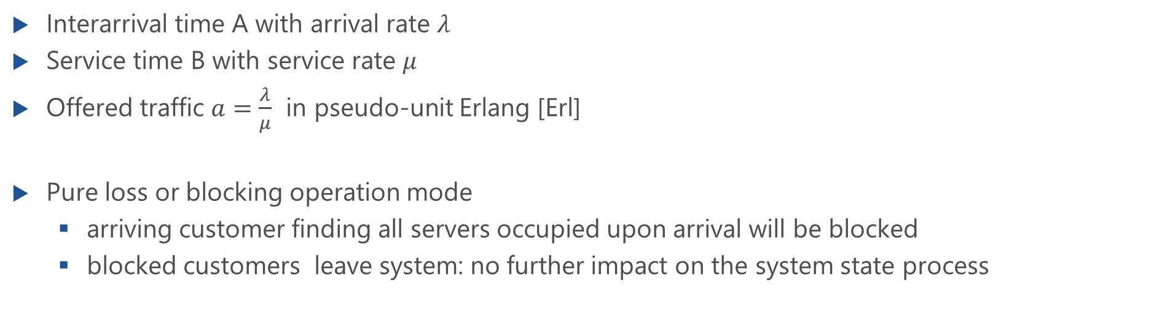
Loss System M/M/n
Interarrival time A with arrival rate $λ$
Service time B with service rate $μ$
Offered traffic $a=\frac{λ}{μ}$ in pseudo-unit Erlang [Erl]
Pure loss or blocking operation mode
arriving customer finding all servers occupied upon arrival will be blocked
blocked customers leave system: no further impact on the system state process

Slide 6
State Process and State Probabilities
Erlang formula for loss systems

Slide 7
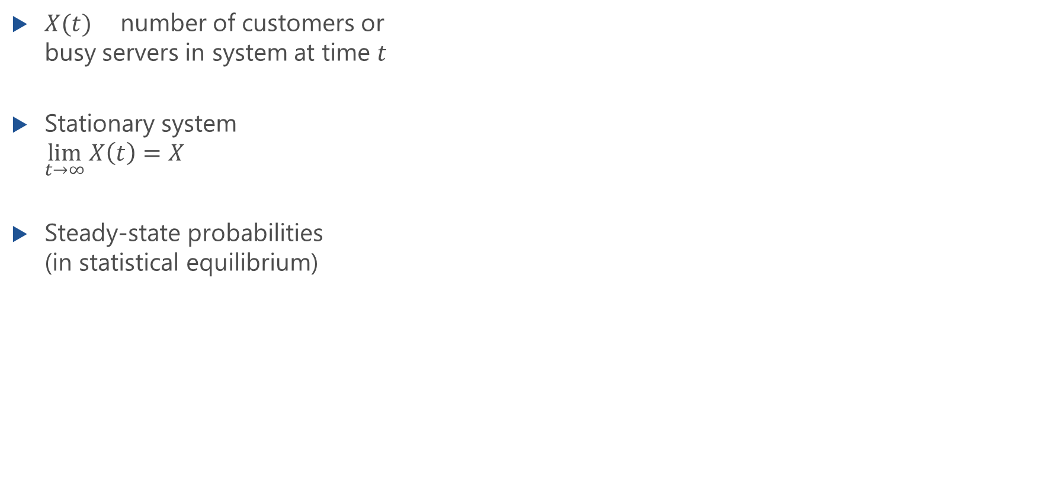
State Process of M/M/n Loss System
$X(t)$ number of customers or busy servers in system at time $t$
Stationary system $\lim_{t→∞}{X\left(t\right)}=X$
Steady-state probabilities (in statistical equilibrium)
x(i) = P(X=i) , i=0,1, ...

Slide 8
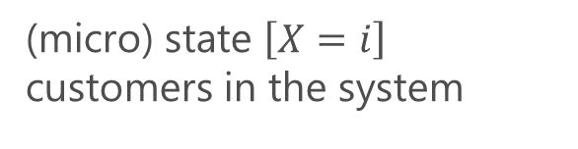
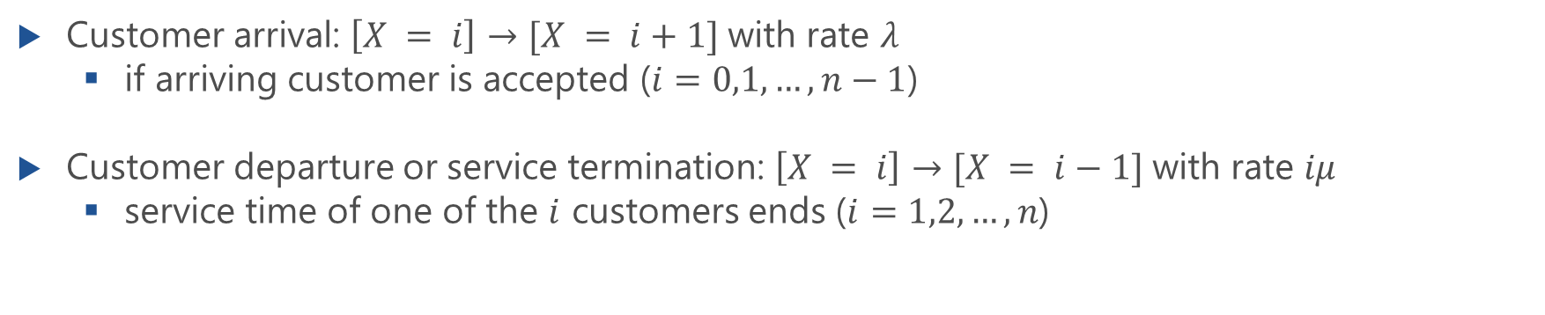
State Transition Diagram
(micro) state $\left[X=i\right]$ customers in the system
Customer arrival: $\left[X = i\right]→[X = i+1]$with rate $λ$
if arriving customer is accepted ($i=0,1,…,n−1$)
Customer departure or service termination: $\left[X = i\right]→[X = i−1]$with rate $iμ$
service time of one of the $i$ customers ends ($i=1,2,…,n$)

Slide 9
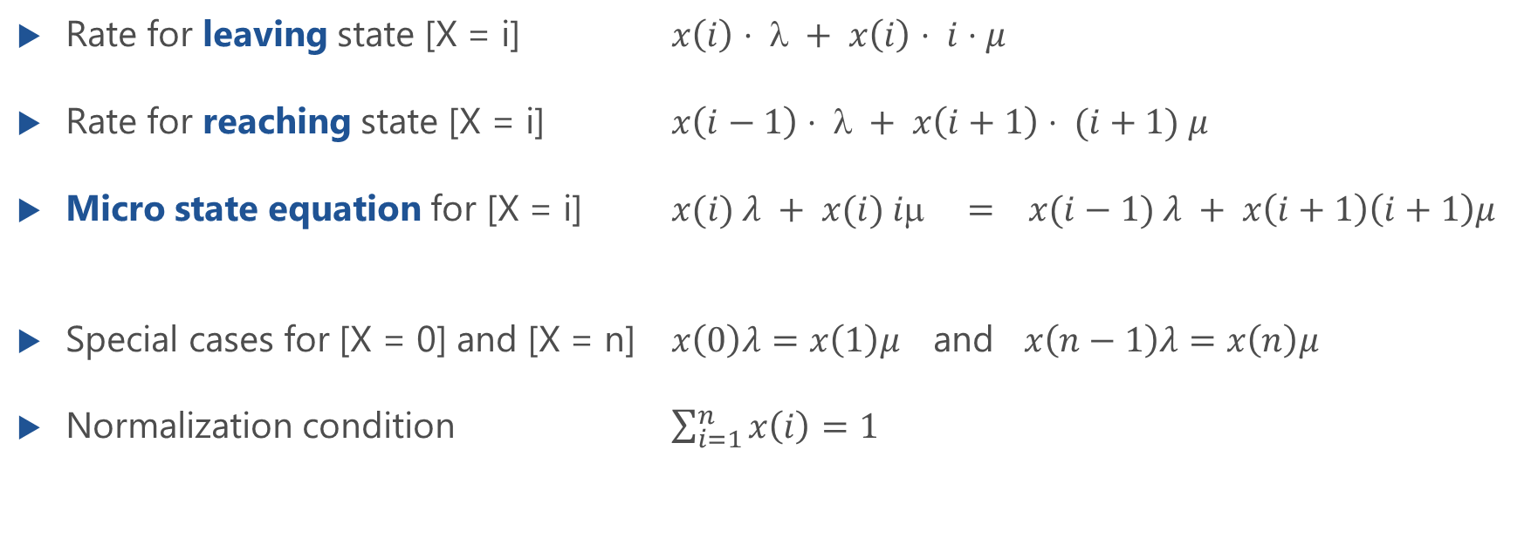
Micro State Equations
Rate for leaving state [X = i] $x\left(i\right)⋅ λ + x\left(i\right)⋅ i⋅μ$
Rate for reaching state [X = i] $x\left(i−1\right)⋅ λ + x\left(i+1\right)⋅ (i+1) μ$
Micro state equation for [X = i] $x(i) λ + x(i) iμ = x(i−1) λ + x\left(i+1\right)\left(i+1\right)μ$
Special cases for [X = 0] and [X = n] $x\left(0\right)λ=x\left(1\right)μ$ and $x\left(n−1\right)λ=x\left(n\right)μ$
Normalization condition $\sum_{i=1}^{n}{x\left(i\right)=1}$

Slide 10
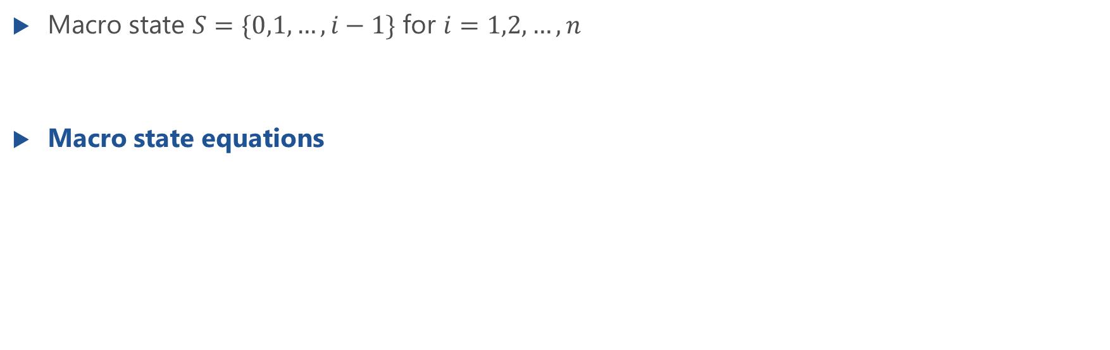
Macro State Equations
Macro state $S=\{0,1,…,i−1\}$ for $i=1,2,…,n$
Macro state equations

Slide 11
Macro State Equations: Solution
Lecture
Macro state equations

Slide 12
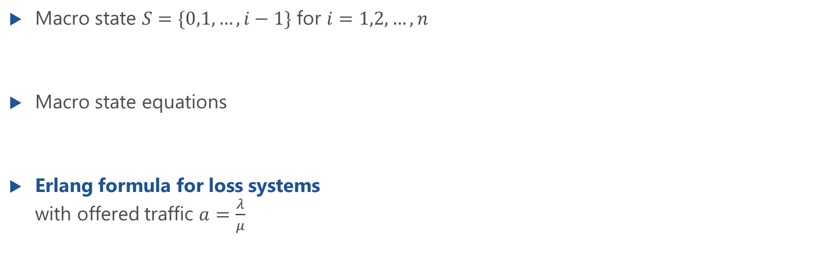
Macro State Equations and Erlang Formula for Loss Systems
Macro state $S=\{0,1,…,i−1\}$ for $i=1,2,…,n$
Macro state equations
Erlang formula for loss systems with offered traffic $a=\frac{λ}{μ}$

Slide 13
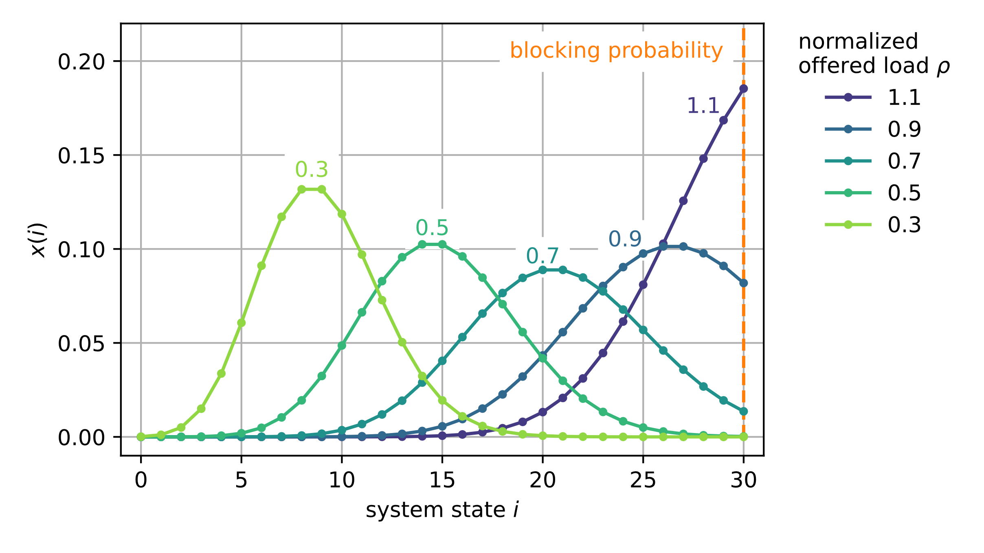
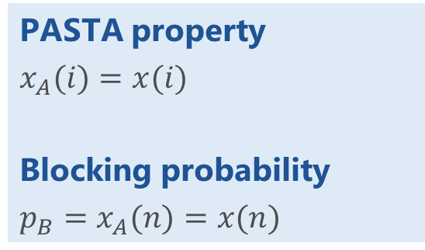
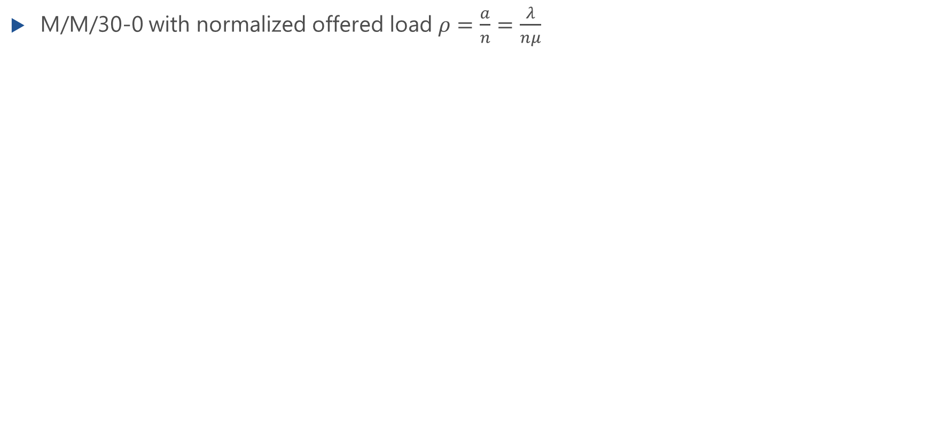
Steady State Distribution
M/M/30-0 with normalized offered load $ρ=\frac{a}{n}=\frac{λ}{nμ}$
PASTA property
$x_{A}(i)=x(i)$
Blocking probability
$p_{B}=x_{A}(n)=x(n)$

Slide 14
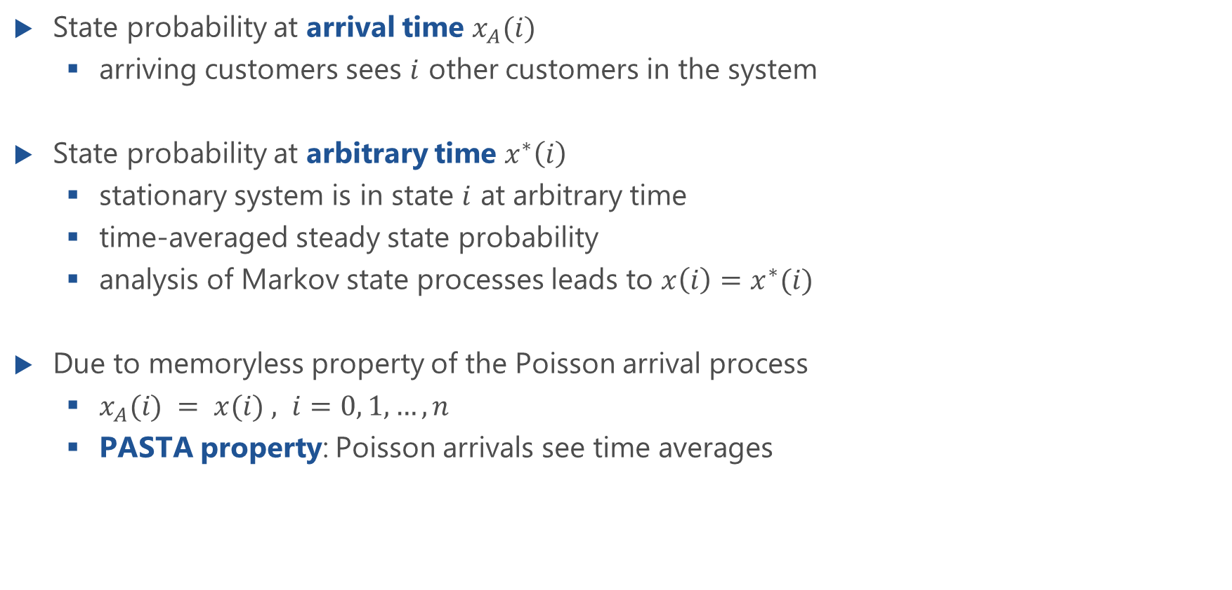
State Probability at Arbitrary and Arrival Times
State probability at arrival time $x_{A}(i)$
arriving customers sees $i$ other customers in the system
State probability at arbitrary time $x^{∗}\left(i\right)$
stationary system is in state $i$ at arbitrary time
time-averaged steady state probability
analysis of Markov state processes leads to $x\left(i\right)=x^{∗}(i)$
Due to memoryless property of the Poisson arrival process
$x_{A}(i) = x(i) , i=0, 1, …, n$
PASTA property: Poisson arrivals see time averages

Slide 15
Other System Characteristics
Blocking probability (Erlang-B formula), carried traffic, utilization

Slide 16
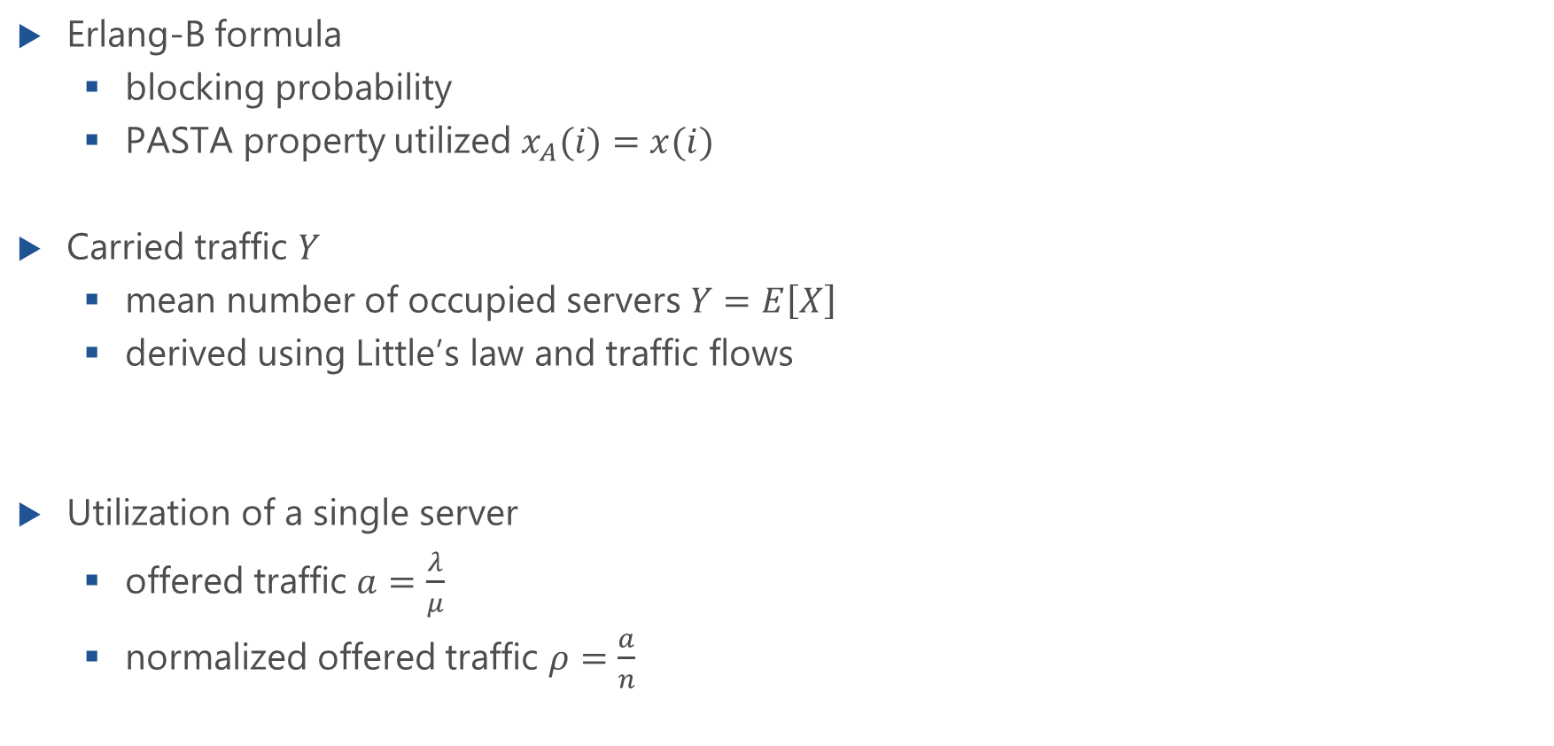
System Characteristics
Erlang-B formula
blocking probability
PASTA property utilized $x_{A}(i)=x(i)$
Carried traffic $Y$
mean number of occupied servers $Y=E\left[X\right]$
derived using Little’s law and traffic flows
Utilization of a single server
offered traffic $a=\frac{λ}{μ}$
normalized offered traffic $ρ=\frac{a}{n}$

Slide 17
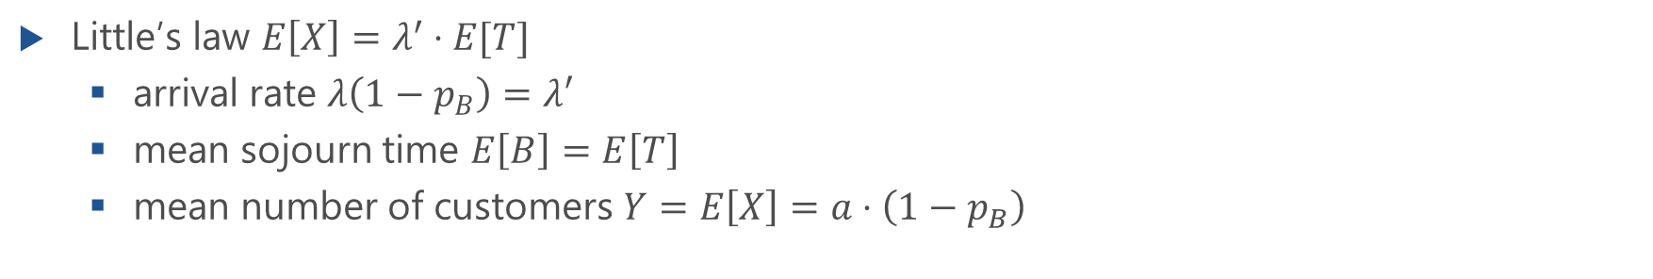
Traffic Flows in M/M/n Loss System
Little’s law $E\left[X\right]=λ^{′}⋅E[T]$
arrival rate $λ\left(1−p_{B}\right)=λ′$
mean sojourn time $E\left[B\right]=E\left[T\right]$
mean number of customers $Y=E\left[X\right]=a⋅\left(1−p_{B}\right)$

Slide 18
Generalization to M/GI/n-0
Insensitivity or robustness property

Slide 19
Insensitivity or Robustness Property
Erlang formula provides steady state probabilities for M/M/n loss system
Generalization to M/GI/n-0
Erlang formula is also valid for loss systems M/GI/n
proof in literature, e.g. by Syski
Insensitivity or robustness property
extends applicability of Erlang formula and Erlang-B formula considerably in practice

Slide 20
Example: M/GI/1-0
Lecture

Slide 21
Modeling Examples and Applications
Dimensioning, economy of scale

Slide 22
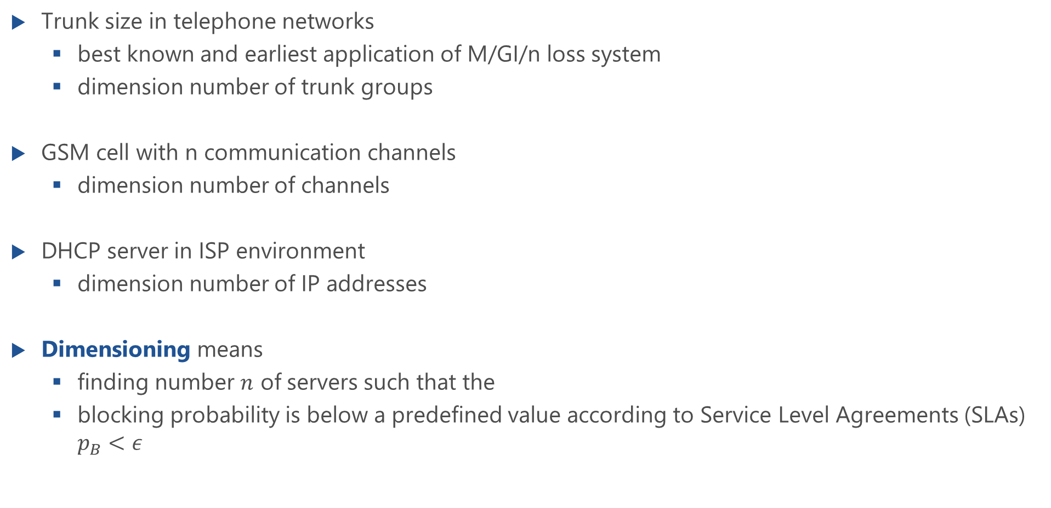
Dimensioning of Systems
Trunk size in telephone networks
best known and earliest application of M/GI/n loss system
dimension number of trunk groups
GSM cell with n communication channels
dimension number of channels
DHCP server in ISP environment
dimension number of IP addresses
Dimensioning means
finding number $n$ of servers such that the
blocking probability is below a predefined value according to Service Level Agreements (SLAs) $p_{B}<ε$

Slide 23
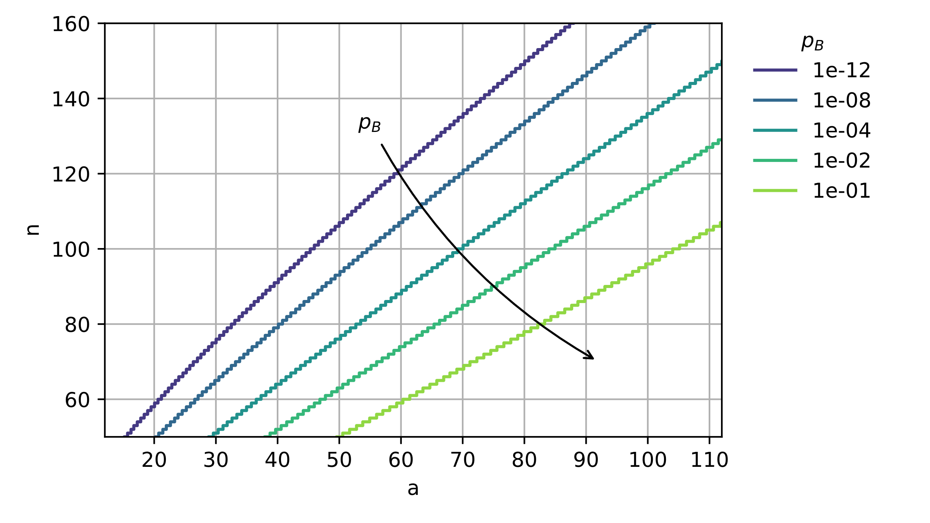
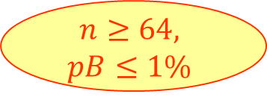
Numerical Solution: Dimensioning
Efficient implementation of Erlang-B formula: see script “4.1 M/M/n-0 loss system: Erlang-B formula” https://modeling.systems/
a=50 Erl
$$n≥64,$$
$$pB≤1\%$$

Slide 24
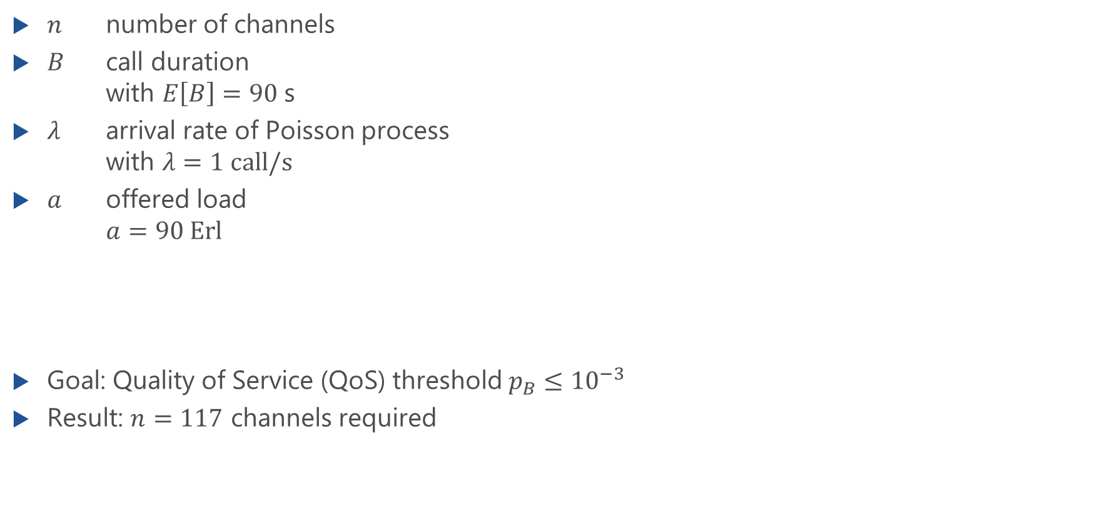
Example: GSM Cell
$n$ number of channels
$B$ call duration with $E\left[B\right]=90$s
$λ$ arrival rate of Poisson process with $λ=1 call/s$
$a$ offered load $a=90 Erl$
Goal: Quality of Service (QoS) threshold $p_{B}≤{10}^{−3}$
Result: $n=117$ channels required

Slide 25
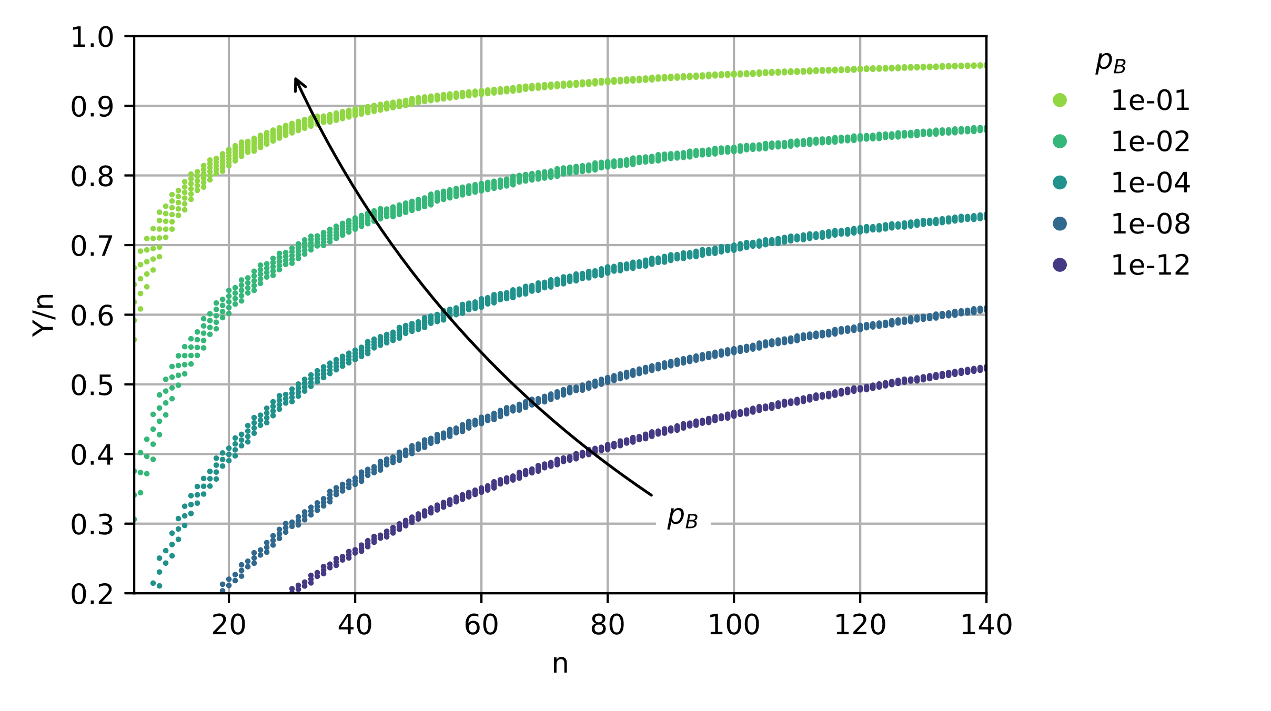
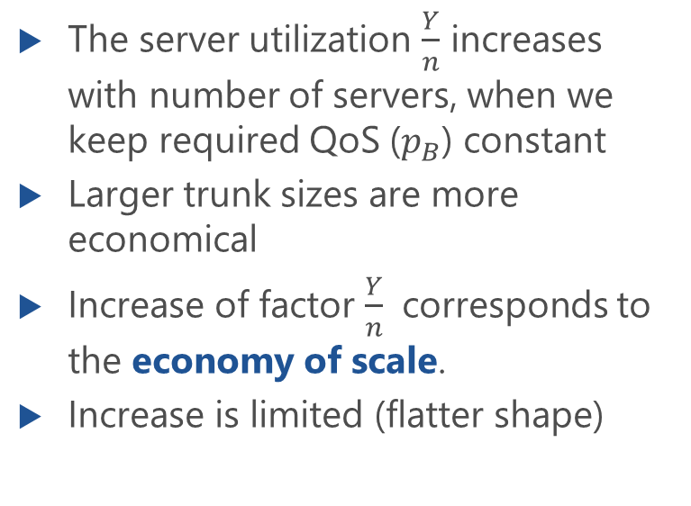
Economy of Scale
The server utilization $\frac{Y}{n}$ increases with number of servers, when we keep required QoS ($p_{B}$) constant
Larger trunk sizes are more economical
Increase of factor $\frac{Y}{n}$ corresponds to the economy of scale.
Increase is limited (flatter shape)

Slide 26
Economy of Scale in Loss Systems
Subsystem 1a
λ₁ = λ
M
1
.
.
.
M
n
p_{B1}
1
λ₂ = 2 λ
M
μ
.
.
.
Subsystem 1b
M
2n
grouping
p_{B2}
λ₁ = λ
M
1
.
μ
.
.
n
System 2
p_{B1}
M
μ
System 1

Slide 27


Example: Several Cells
Lecture

